Slide 1
Implementation
Cloud Storage
On Google Drive
Christian Frans Mukuan
Muladi Aprianto Manalu

Slide 2
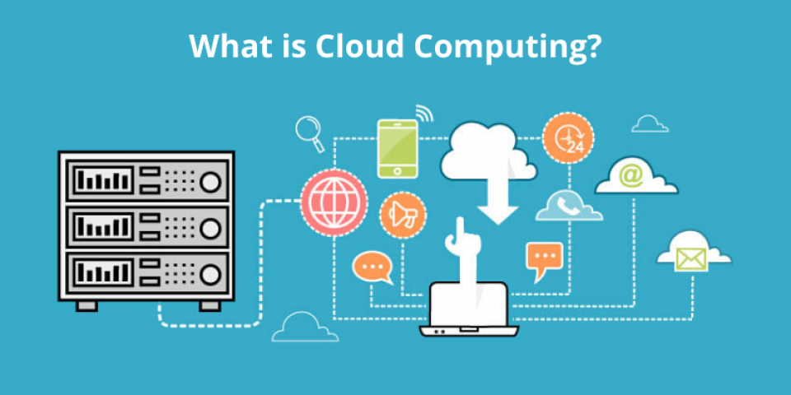
01
COMPANY
You could enter a subtitle here if you need it

Slide 3
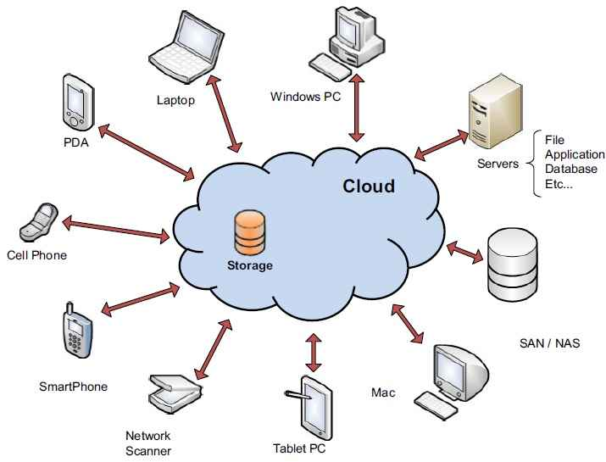
What is Cloud Storage?

Slide 4
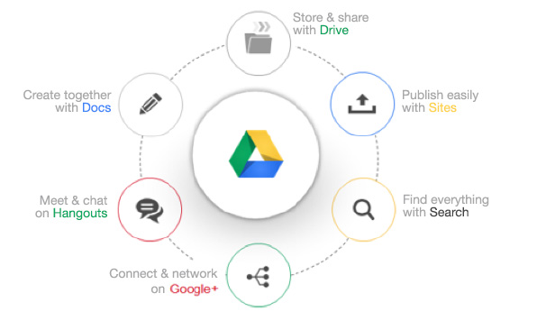
What is Google Drive?

Slide 5
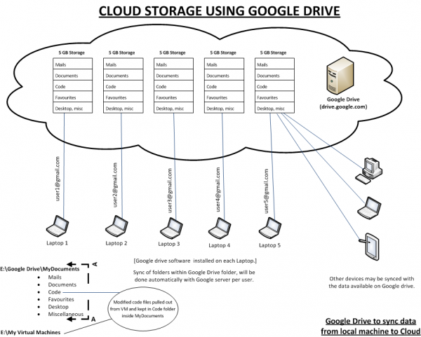

Slide 6
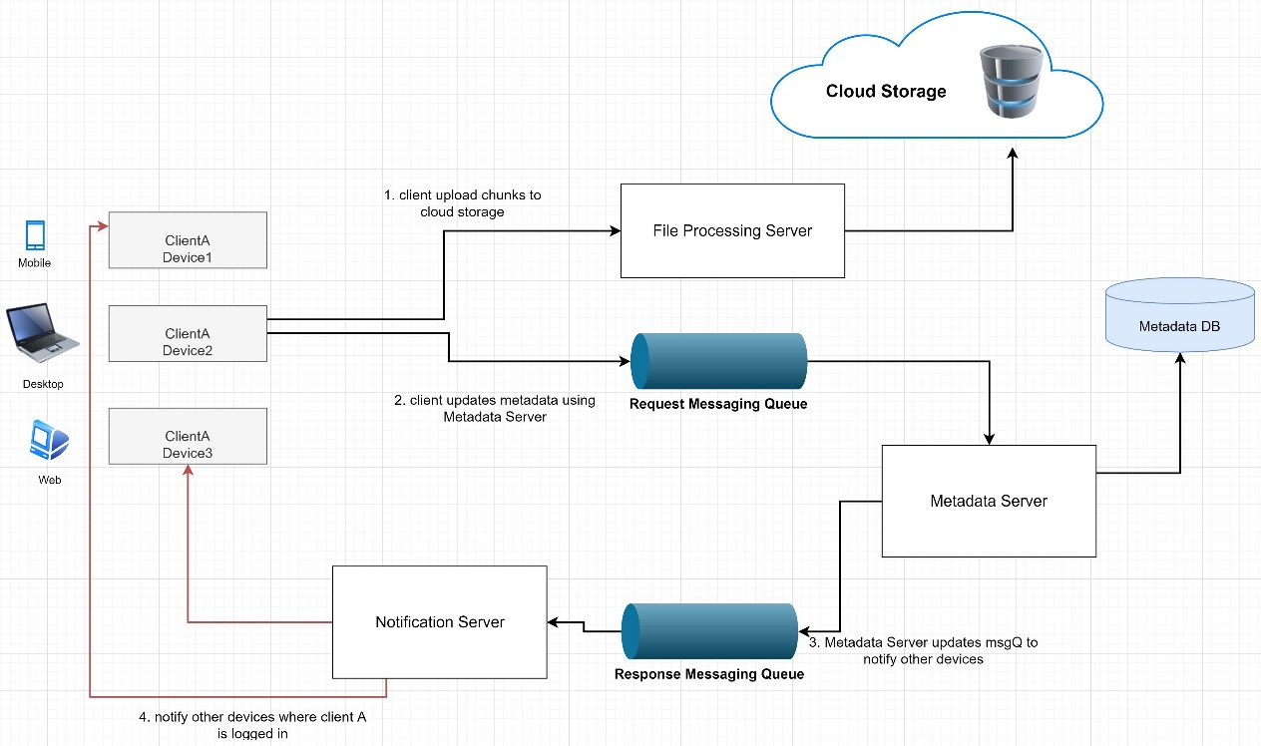
Work Flow Cloud Storage Architecture on Google Drive
Client upload chunks to Cloud Storage
Client updates metadata using Metadata Server
Metadata Server updates Messaging Query
Notify other devices where client A is logged in

Slide 7
Advantages of Google Drive
Access your files everywhere
You can edit and make changes to the files
Able to access with various devices
View any types of file
15GB Free Disk Space

Slide 8
Disadvantages of Google Drive
Dependency on Internet Speed
Dependency on a Third Party
High Cost for Huge Data

Slide 9
—Conclusion
Google Drive with a great deal of promise, aren’t designed to be high performing file systems but rather extremely scalable, easy to manage storage systems. They use a different approach to data resiliency, Redundant array of inexpensive nodes, coupled with object based or object-like file systems and data replication (multiple copies of the data), to create a very scalable storage system.

Slide 10
THANKS!!
Do you have any questions?

